Slide 1

Project 6 Simulation of 5G NR MAC Layer

Slide 2
Table of Contents
Introduction to MAC Layer
Functions & Structure Overview
Downlink & Uplink Resource Allocation
Code
Output

Slide 3
Project Overview
The 5G NR (New Radio) technology revolutionizes mobile communication with enhanced speeds and reduced latency. Central to its operation is the Medium Access Control (MAC) layer, which allocates bandwidth resources efficiently for both uplink and downlink communications. This project aims to simulate the 5G MAC layer’s resource allocation processes using C++.
Overview:
The project will develop a C++ model to simulate how the MAC layer distributes bandwidth among users based on varying data demands. It includes scenarios with different user counts and data requests to analyze the impact on network throughput and latency. By implementing and evaluating these simulations, the project seeks to understand how resource allocation affects network performance, providing insights into optimizing bandwidth usage and improving overall system efficiency in real-world 5G environments.

Slide 4
Group members Rajeshwari
Swetav
Sujata
Pavan
Prasad
Shashwat
Bhuvaneshwari
Mentor/Guide:
Abhijeet Kumar

Slide 5
Introduction to MAC Layer

Slide 6
Introduction to Mac
4.1 of 3GPP TS 38.321
The 'Medium Access Control' (MAC) layer receives both user plane and control plane data from the set of logical channels provided by the RLC layer. The MAC layer is responsible for processing this data and mapping onto the Transport Channels which allow data transfer towards the Physical layer
The MAC layer handles logical-channel multiplexing, hybrid-ARQ retransmissions, and scheduling and scheduling-related functions, including handling of different numerologies. It is also responsible for multiplexing/demultiplexing data across multiple component carriers when carrier aggregation is used.
It allocates resources based on scheduling decisions, mapping logical channels to transport channels and subsequently to physical channels.

Slide 7
Structure & Functions Overview

Slide 8
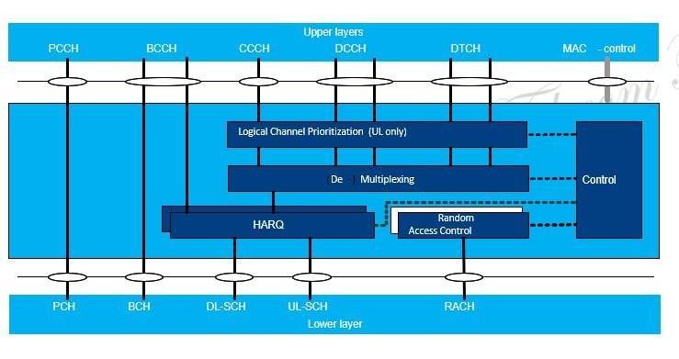
MAC Structure
4.2.2-1 of 3GPP TS 38.321
Fig 1.1 MAC Structure Overview
SIMULATION OF 5G NR MAC LAYER GROUP 4

Slide 9
Functions
4.4 of 3GPP TS 38.321
MAC Services
Data Transfer: The MAC layer handles the transfer of data between different network layers, ensuring that data gets to the right place efficiently.
Radio Resource Allocation: The MAC layer manages how radio resources (like frequency and time slots) are allocated to users, optimizing network performance.
Services Expected from the Physical Layer
Data Transfer Services: The MAC layer relies on the physical layer to handle the actual transmission and reception of data over the air.
HARQ Feedback Signaling: The physical layer provides feedback for Hybrid Automatic Repeat reQuest (HARQ), which helps in error correction by indicating whether a packet was successfully received.
Scheduling Request Signaling: The physical layer helps the MAC layer by signaling when a device needs more resources (e.g., to send more data).
Measurements (e.g., CQI): The physical layer provides measurements like Channel Quality Indication (CQI), which the MAC layer uses to make decisions about resource allocation and data transmission.

Slide 10
structure
4.5 of 3GPP TS 38.321
The MAC entity handles the following transport channel
Broadcast Channel (BCH)
Download Shared Channel(s) (DL-SCH)
Paging Channel (PCH)
Uplink Shared Channel(s) (UL-SCH)
Random Access Channel(s) (Rach)
Scheduling
Assignment of DL and UL resources
HARQ retransmission
Padding
Priority handling of logical channel
Error correction through HARQ
Beam Management
Beam quality feedback
Beam Switch Procedure
RACH procedure
Maintenance of Uplink timing
Timing Advance
Support of Multiple numerology

Slide 11
4.4 of 3GPP TS 38.321
MAC Functions
Mapping between Logical Channels and Transport Channels: The MAC layer maps logical channels (which carry specific types of data) to transport channels that are used for transmission over the air.
Multiplexing of MAC SDUs: The MAC layer combines multiple Service Data Units (SDUs) into a single MAC Protocol Data Unit (PDU) for efficient transmission.
Demultiplexing of MAC SDUs: At the receiving end, the MAC layer splits the received MAC PDU back into individual SDUs to deliver them to the appropriate higher layers.
Error Correction through HARQ: The MAC layer uses HARQ to correct errors during data transmission by retransmitting lost or corrupted packets.
Logical Channel Prioritization: The MAC layer prioritizes data from different logical channels based on their importance, ensuring that critical data gets transmitted first.
SIMULATION OF 5G NR MAC LAYER GROUP 4

Slide 12
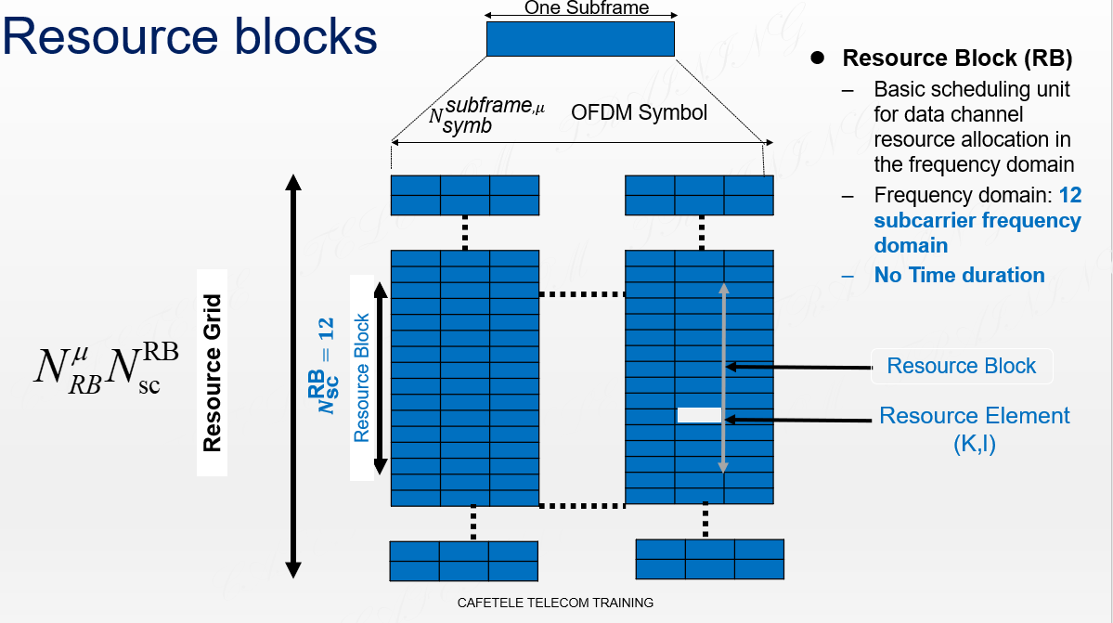
Fig 1.2 Resource Block Diagram
SIMULATION OF 5G NR MAC LAYER GROUP 4

Slide 13
Resource Blocks (RB)
4.4.4 of 3GPP TS 38.211
A Resource Block is the smallest unit of frequency that can be allocated to a user for data transmission.
A resource block is defined as 12(N_RB_sc) consecutive subcarriers in the frequency domain
Downlink (DL) Allocation:
Scheduling Decisions: The gNodeB (5G base station) decides how many RBs to allocate for downlink data to each user.
Mapping: The allocated RBs are specified in terms of their starting position in the frequency domain and the duration in the time domain.
Uplink (UL) Allocation:
UE Requests: UEs request resources for uplink transmission, and the gNodeB grants RBs for this purpose.
Mapping: Similar to downlink, the allocated RBs are specified for uplink transmission
SIMULATION OF 5G NR MAC LAYER GROUP 4

Slide 14
Downlink & Uplink Resource Allocation

Slide 15
Down-link Resource Allocation
7 of 3GPP TS 38.211
Scheduling: The MAC scheduler decides how to allocate downlink resources to different User Equipment (UEs) based on various factors like Quality of Service (QoS) requirements, channel conditions, and fairness.
Resource Block (RB) Allocation: The available bandwidth is divided into multiple Resource Blocks (RBs). Each RB consists of a set of subcarriers in the frequency domain and a set of symbols in the time domain. The MAC layer allocates these RBs to UEs for downlink transmission.
Transmission Power Control: The MAC layer may also manage transmission power for downlink channels to ensure efficient use of the spectrum while minimizing interference.
HARQ (Hybrid Automatic Repeat reQuest): The downlink transmission is monitored, and if errors are detected, retransmission is triggered through HARQ mechanisms.
SIMULATION OF 5G NR MAC LAYER GROUP 4

Slide 16
Uplink resource allocation
6 of 3GPP TS 38.211
Grant-Based Uplink: The MAC layer allocates uplink resources through a grant-based mechanism, where the network assigns specific RBs to UEs for uplink transmission. The UE sends a scheduling request, and the network responds with a grant indicating the resources allocated.
Grant-Free Uplink: In some cases, especially for low-latency applications, grant-free uplink transmission may be used. UEs can transmit without waiting for a grant, though this requires more sophisticated management to avoid collisions.
Power Control: Similar to downlink, uplink transmissions are subject to power control to manage interference and ensure that transmissions reach the base station with adequate signal strength.
Dynamic Allocation: The allocation can be dynamic, adjusting based on real-time network conditions, traffic load, and UE mobility.

Slide 17
Code

Slide 18
Source: GitHub, LinkedIn
SIMULATION OF 5G NR MAC LAYER GROUP 4

Slide 19
Output

Slide 20
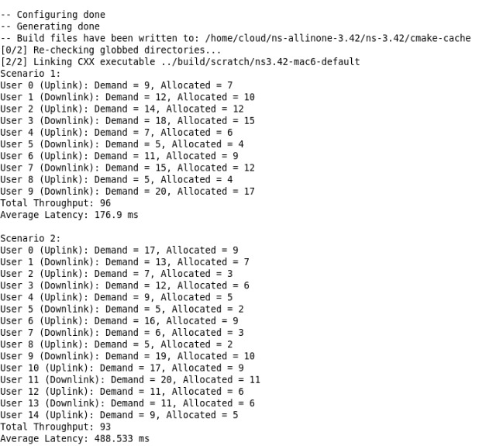
output

Slide 21
Thank You!

